Slide 1
To solve Swift–Hohenberg equation within the framework of PINN for 1-Dimension

Slide 2
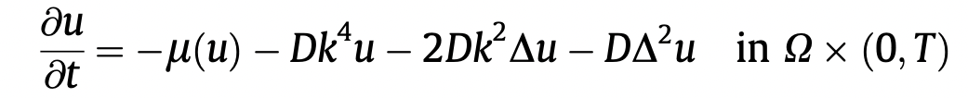
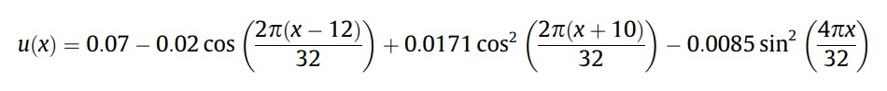
Solving the Swift-Hohenberg equation using PINN
1) Swift-Hohenberg equation is a PDE used to solve for pattern-forming behavior.
2) We have used a PINN model to solve the 1D problem, taking domain as and initial condition as

Slide 3
Validation of PINN
Since the Swift-Hohenberg equation cannot be solved analytically, we use an implicit method called the Finite-Difference method.
Finite Difference method is a way to get an approximate solution of the equation in the form of different values of u.
We use these values to validate the solution that we got from the PINN.

Slide 4
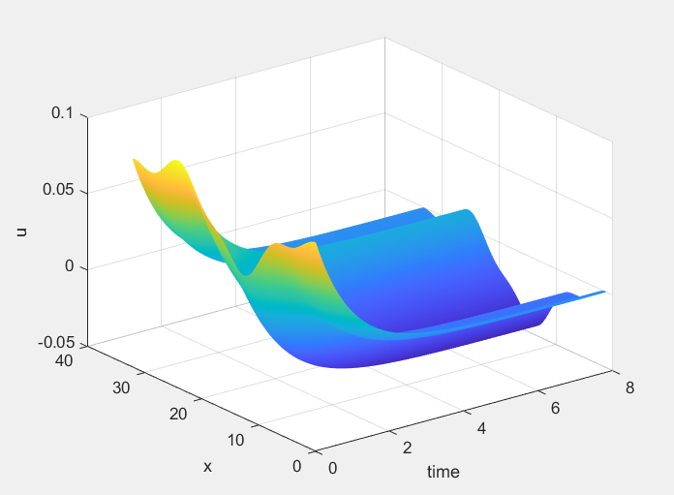
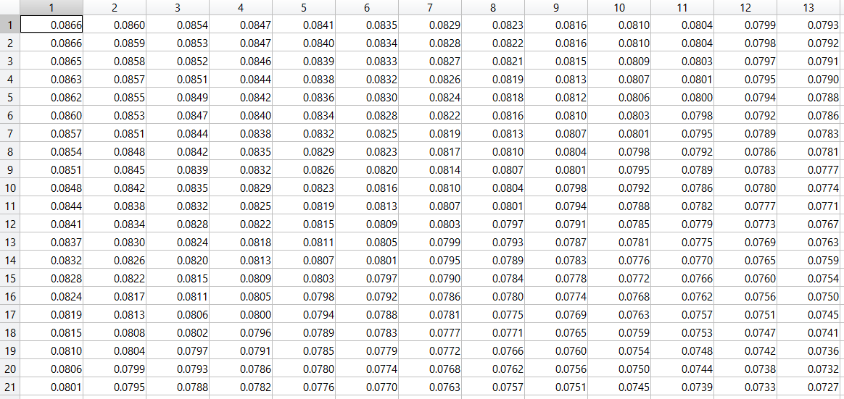
Finite-difference Method
In this method, we approximate derivatives using finite derivatives and find the relation to find u_{i,j+1} in terms of u_{i,j} , u _{1+1,j} , u_{i+2,j} , u _{i-2,j}, u _{i-1,j} where i = space step and j = time step.
Starting from the initial condition for 1-D and taking time step = 7.8125 x 10^(-3) sec, we run a loop for 1000-time steps to get values of u.

Slide 5
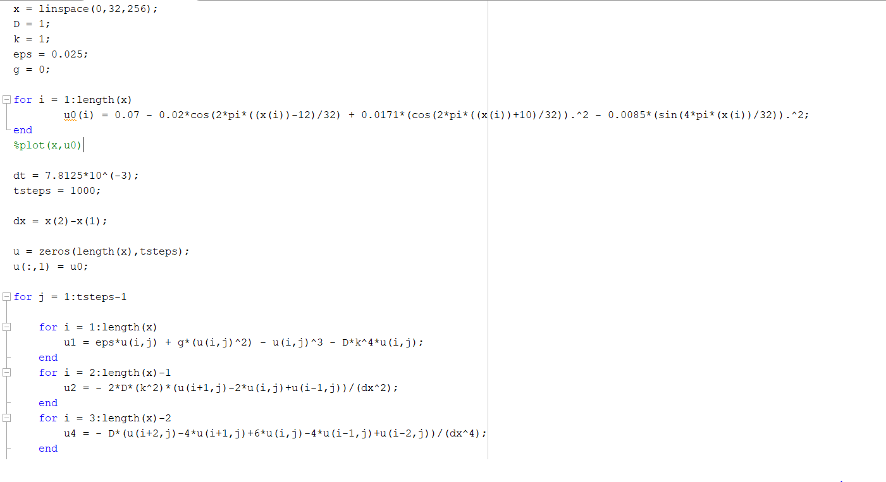
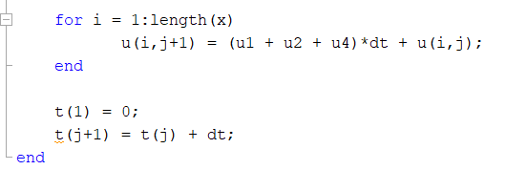

Slide 6
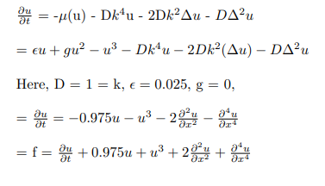
Simplifying the equation for PINN

Slide 7
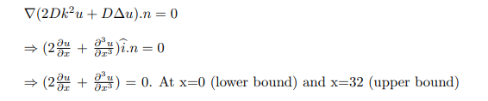
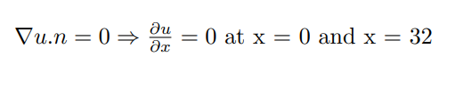
Boundary Conditions
1.
2.

Slide 8

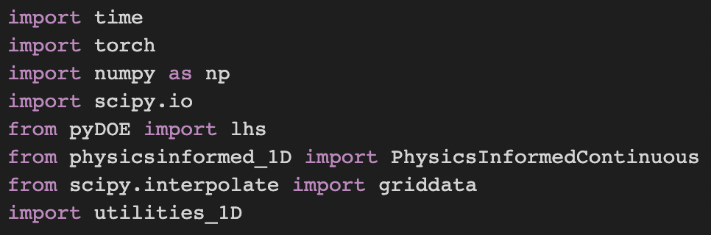
Libraries Used

Slide 9
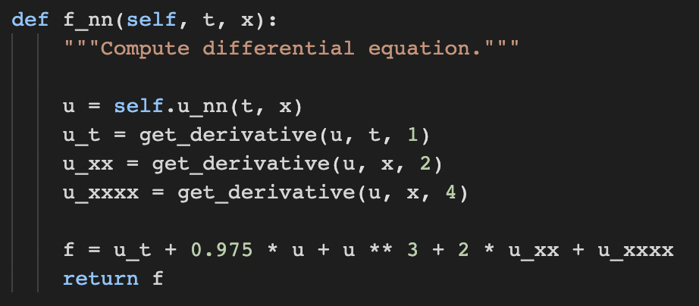
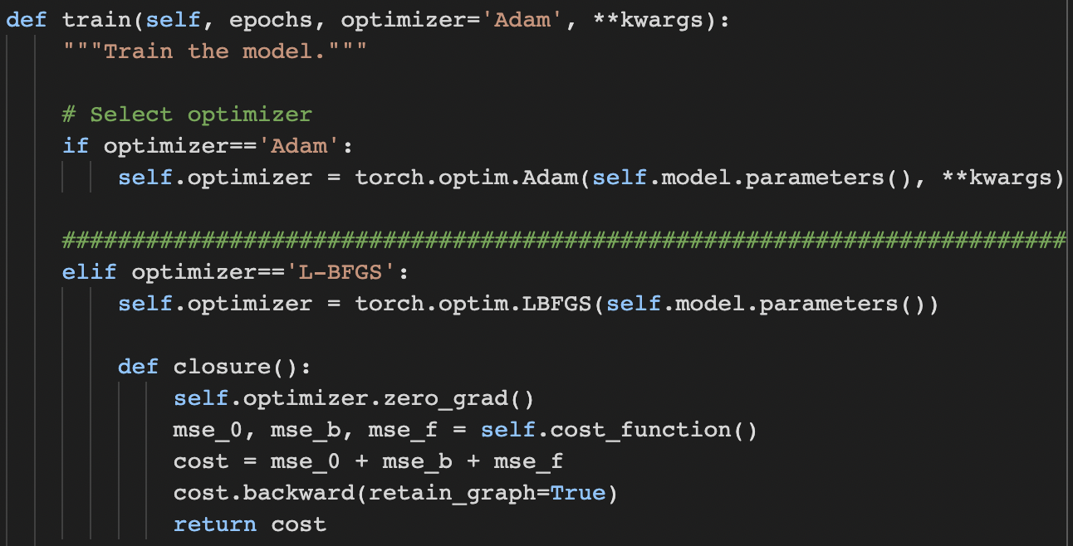
Implementing the equation in PINN
Cost function

Slide 10
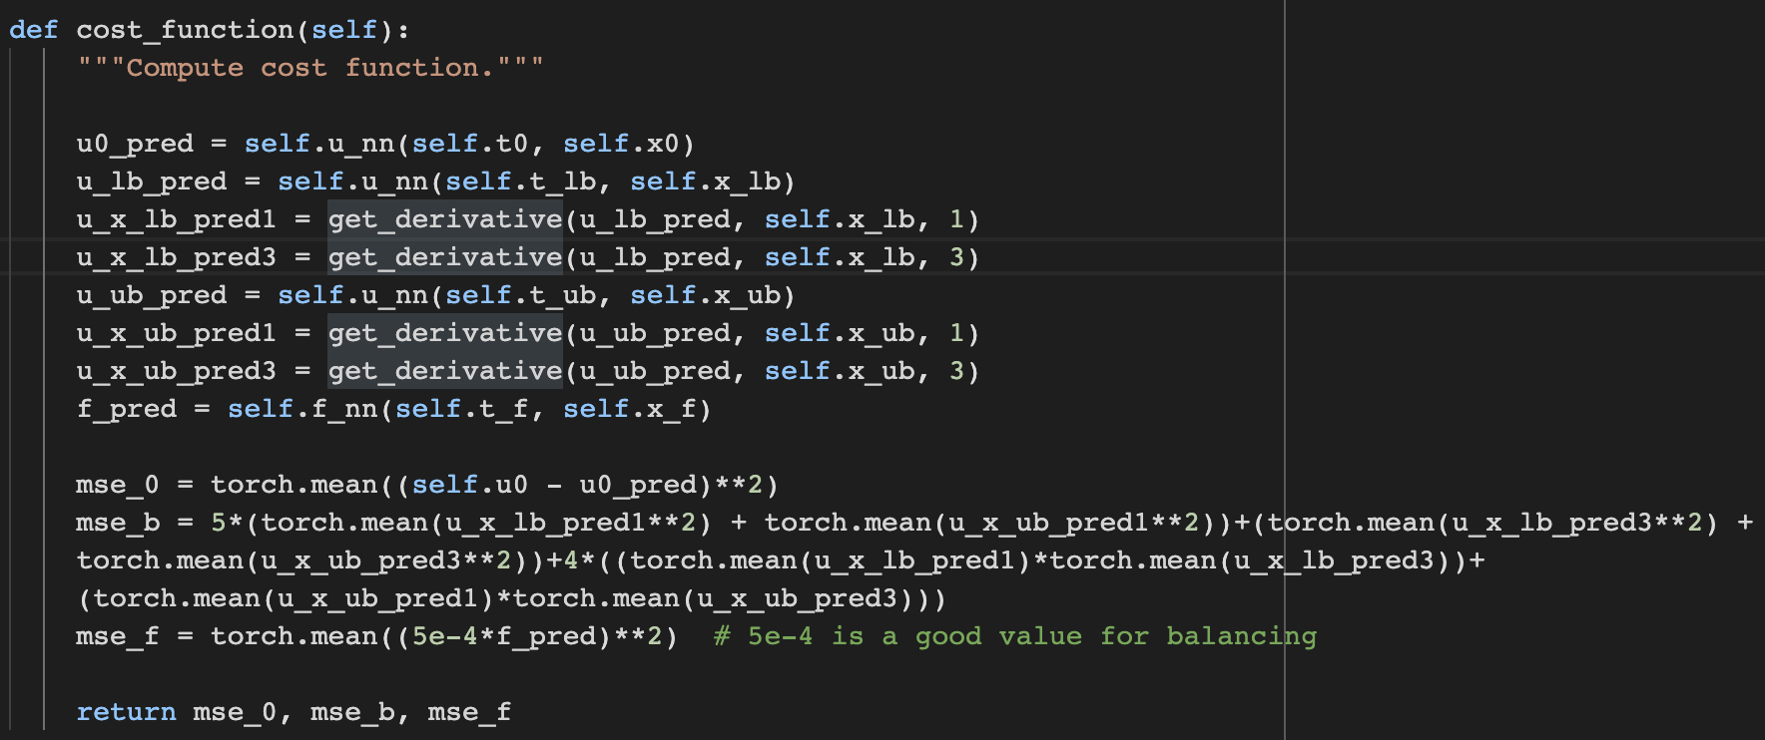
Where, mse_0 => error function at initial condition
mse_b => error function at boundary conditions
mse_f => error function for differential equation (PINN)

Slide 11
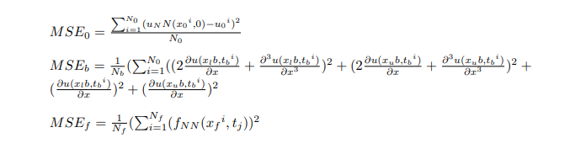
N_b: Labelled data points at boundary
x_lb: Lower bound of domain
x_ub: Upper bound of domain
N_f: Collocation points generated using uniform distribution over 1-D domain

Slide 12
Results
After developing the PINN model, we compare the results generated for different architecture of neural networks and different value of epochs.
1) Same epochs, different architecture
a) same number of hidden layers with different number of neurons
b) different number of hidden layers
2) Different epochs, same architecture

Slide 13
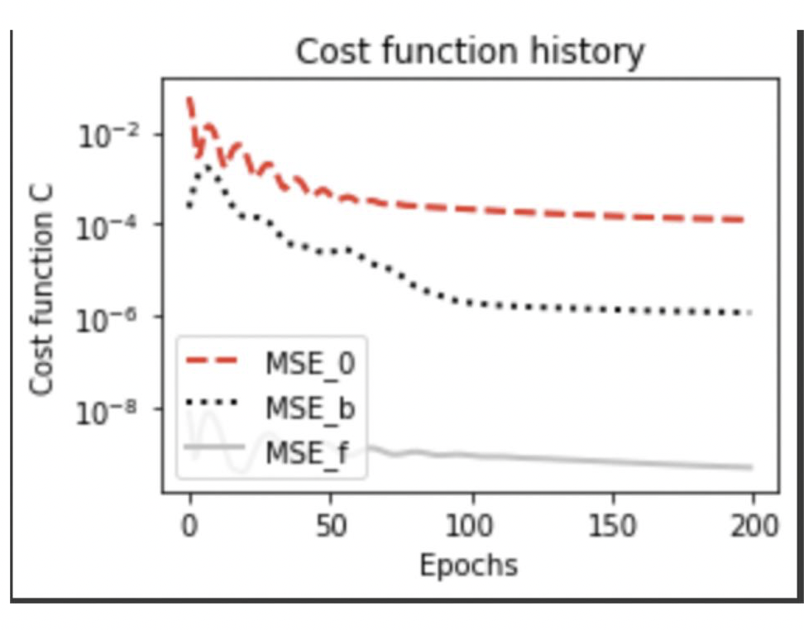
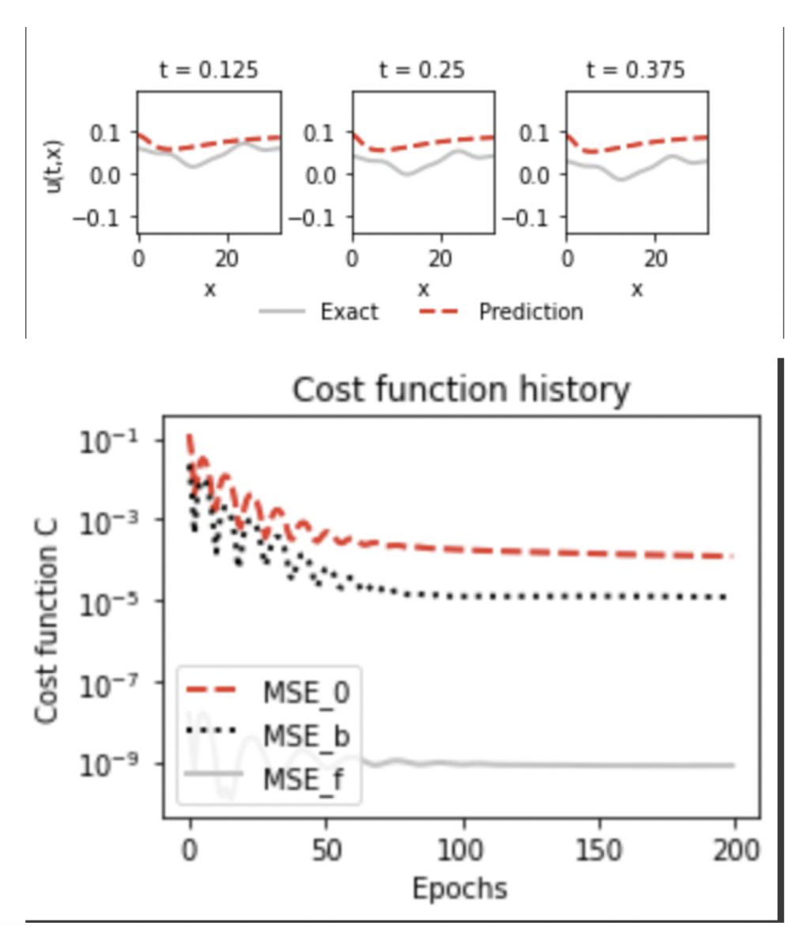
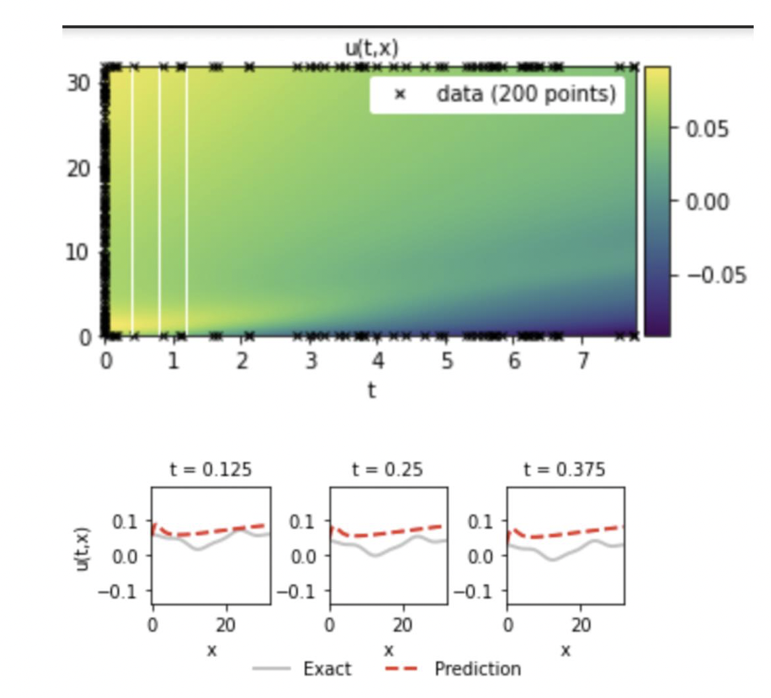
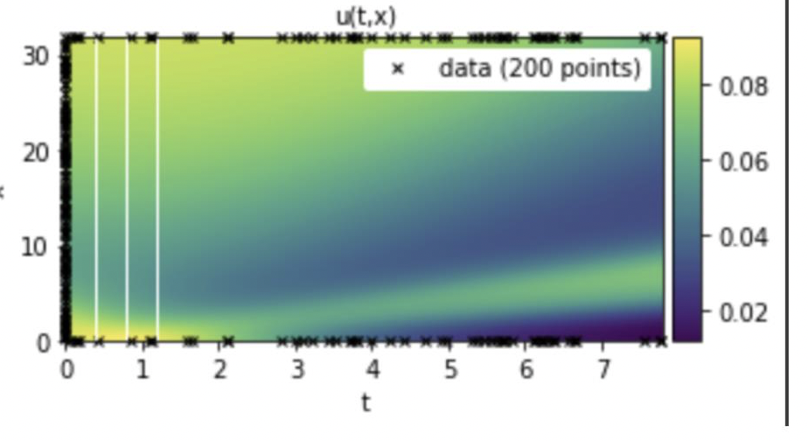
1 a .
[2,60,60,60,1] epoch 200
[2,35,35,35,1] epoch 200

Slide 14
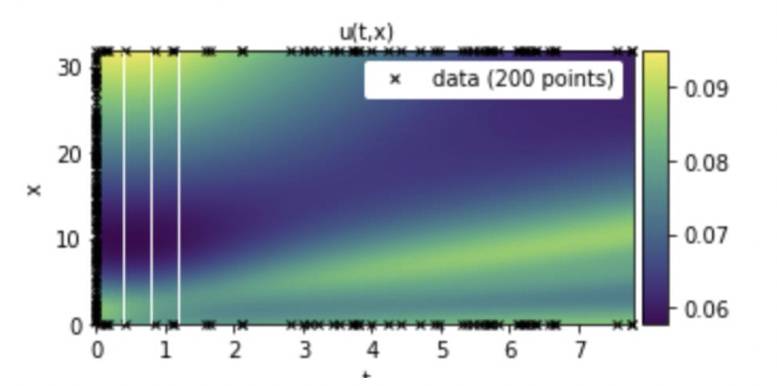
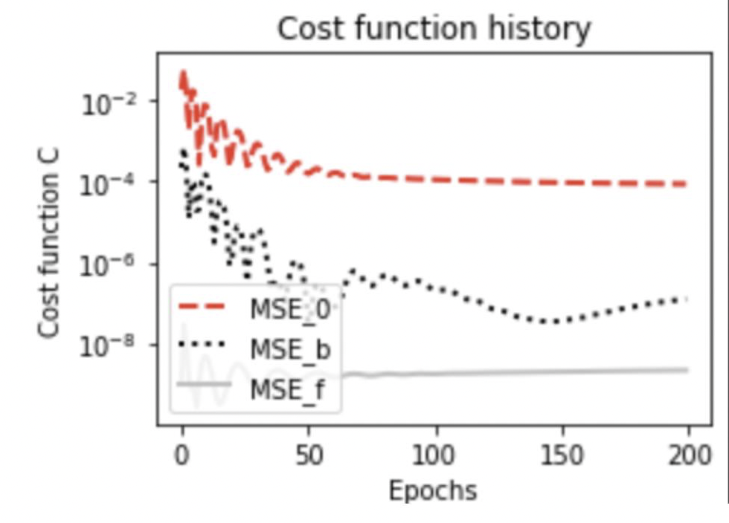
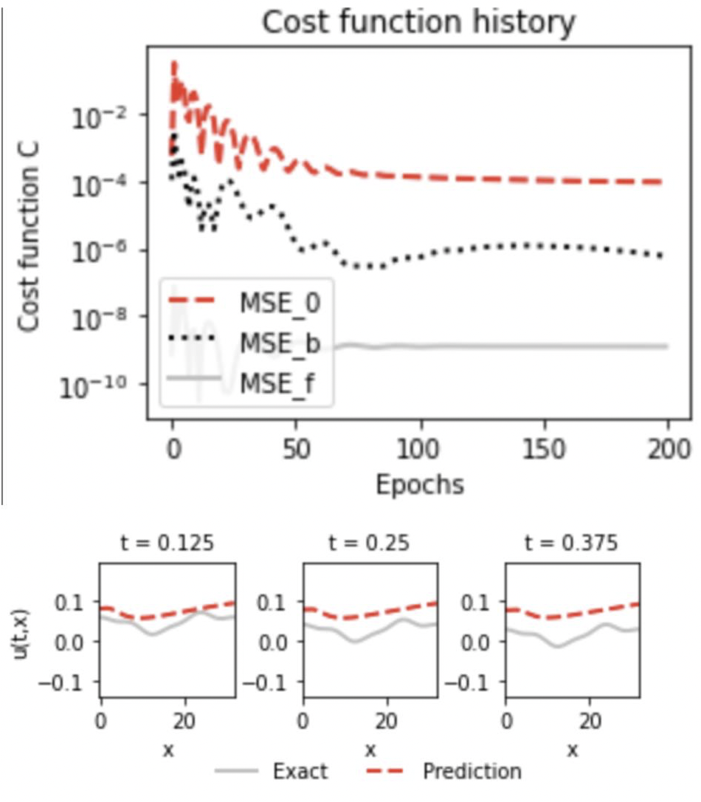
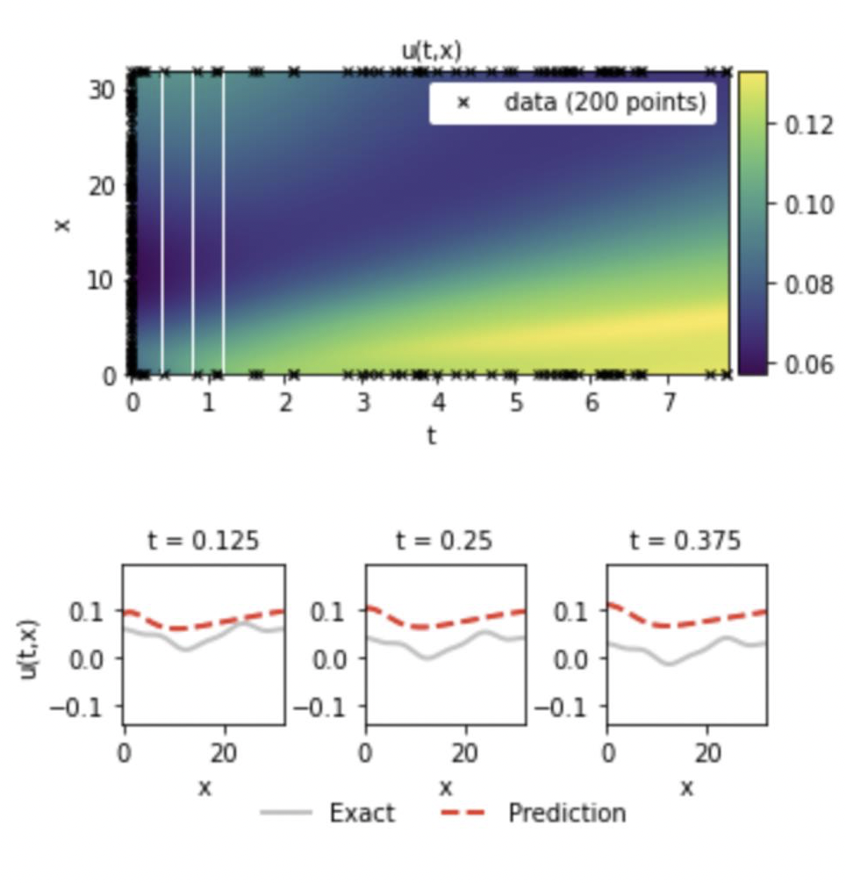
1 b.
[2,150,150,150,150,1] Epoch = 200
[2,120,120,120,120,1] epoch : 200

Slide 15
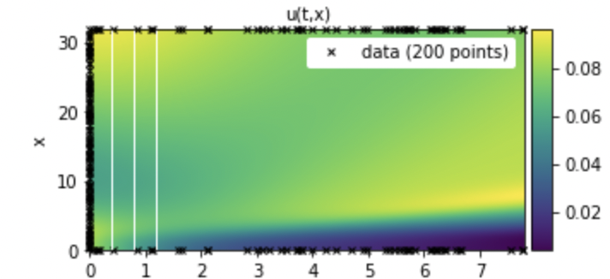
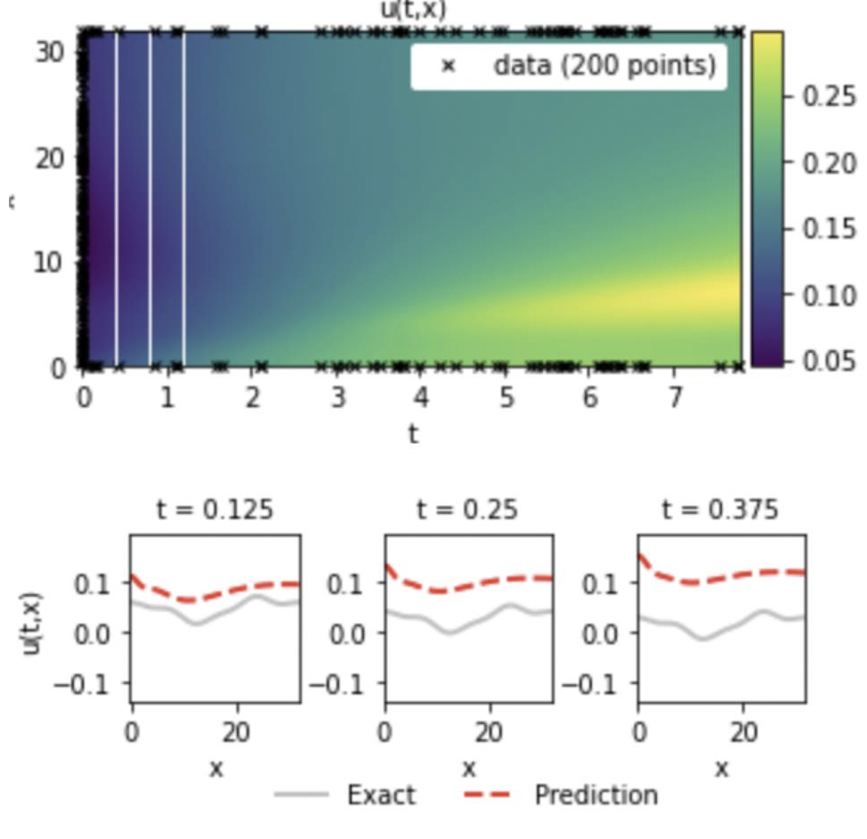
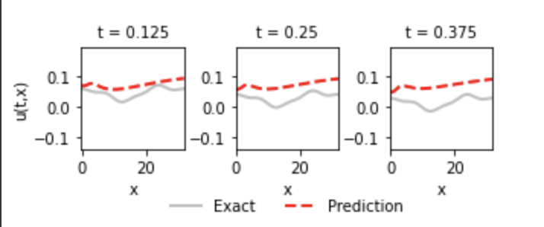
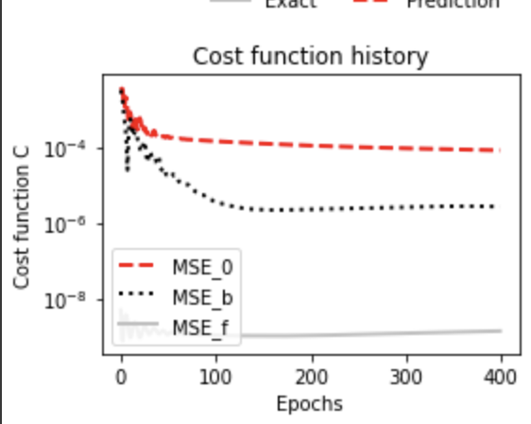
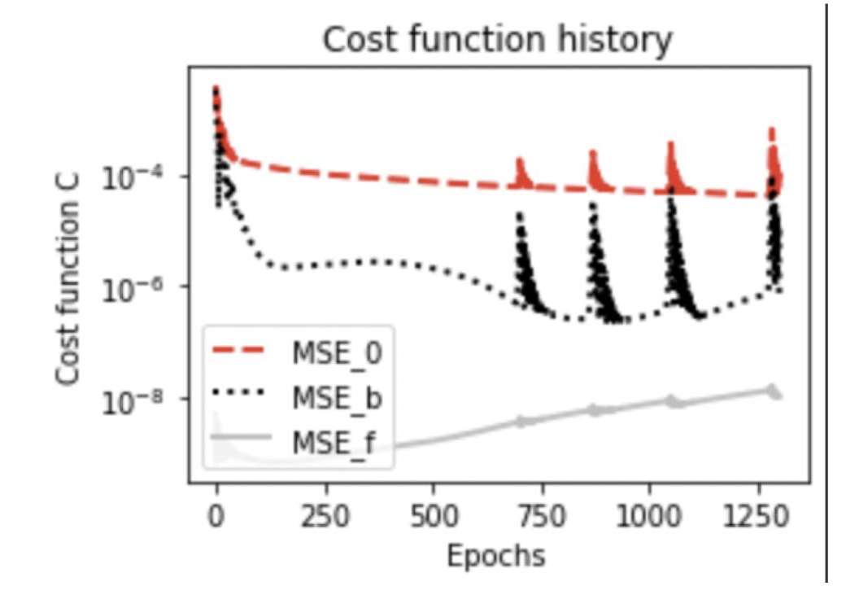
2.
Epoch: 400, [2,40,40,40,1]
Epoch: 1300
[2,40,40,40,1]

Slide 16
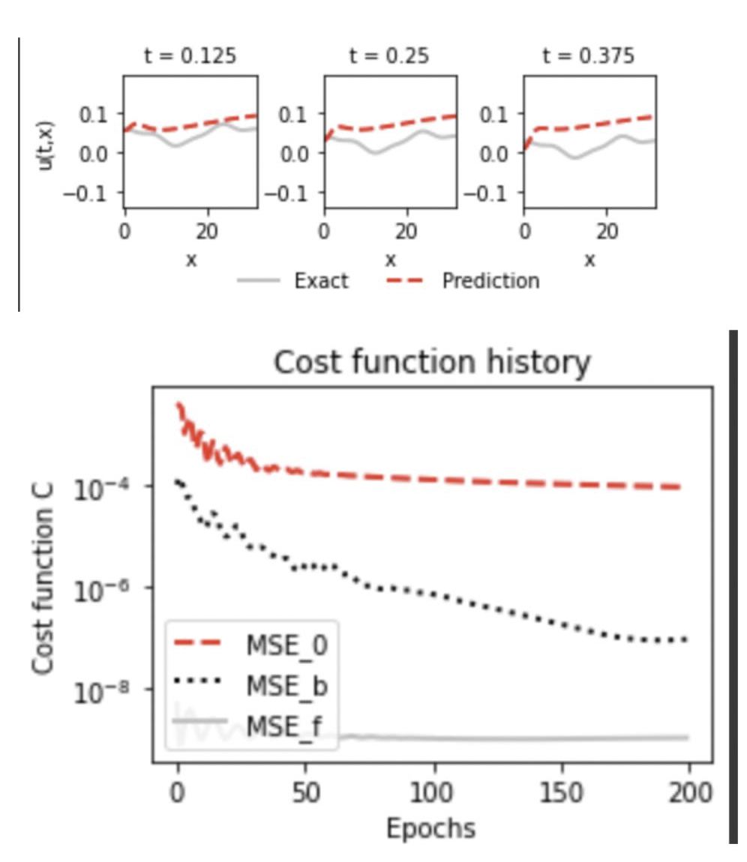
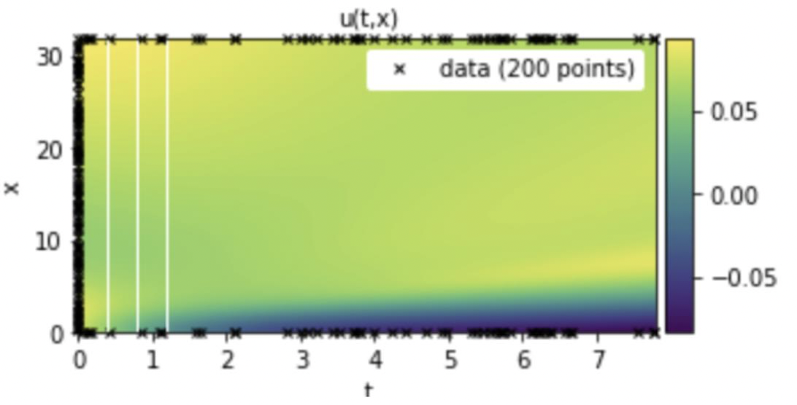
Epoch: 200. [ 2,40,40,40,1]

